Slide 1
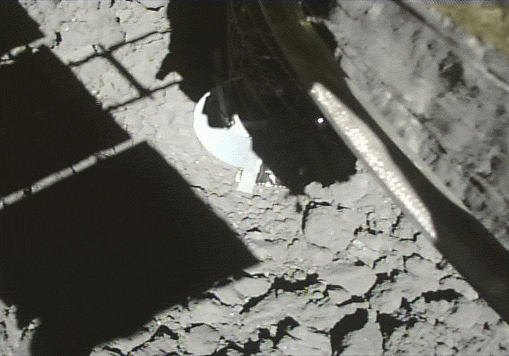

Slide 2
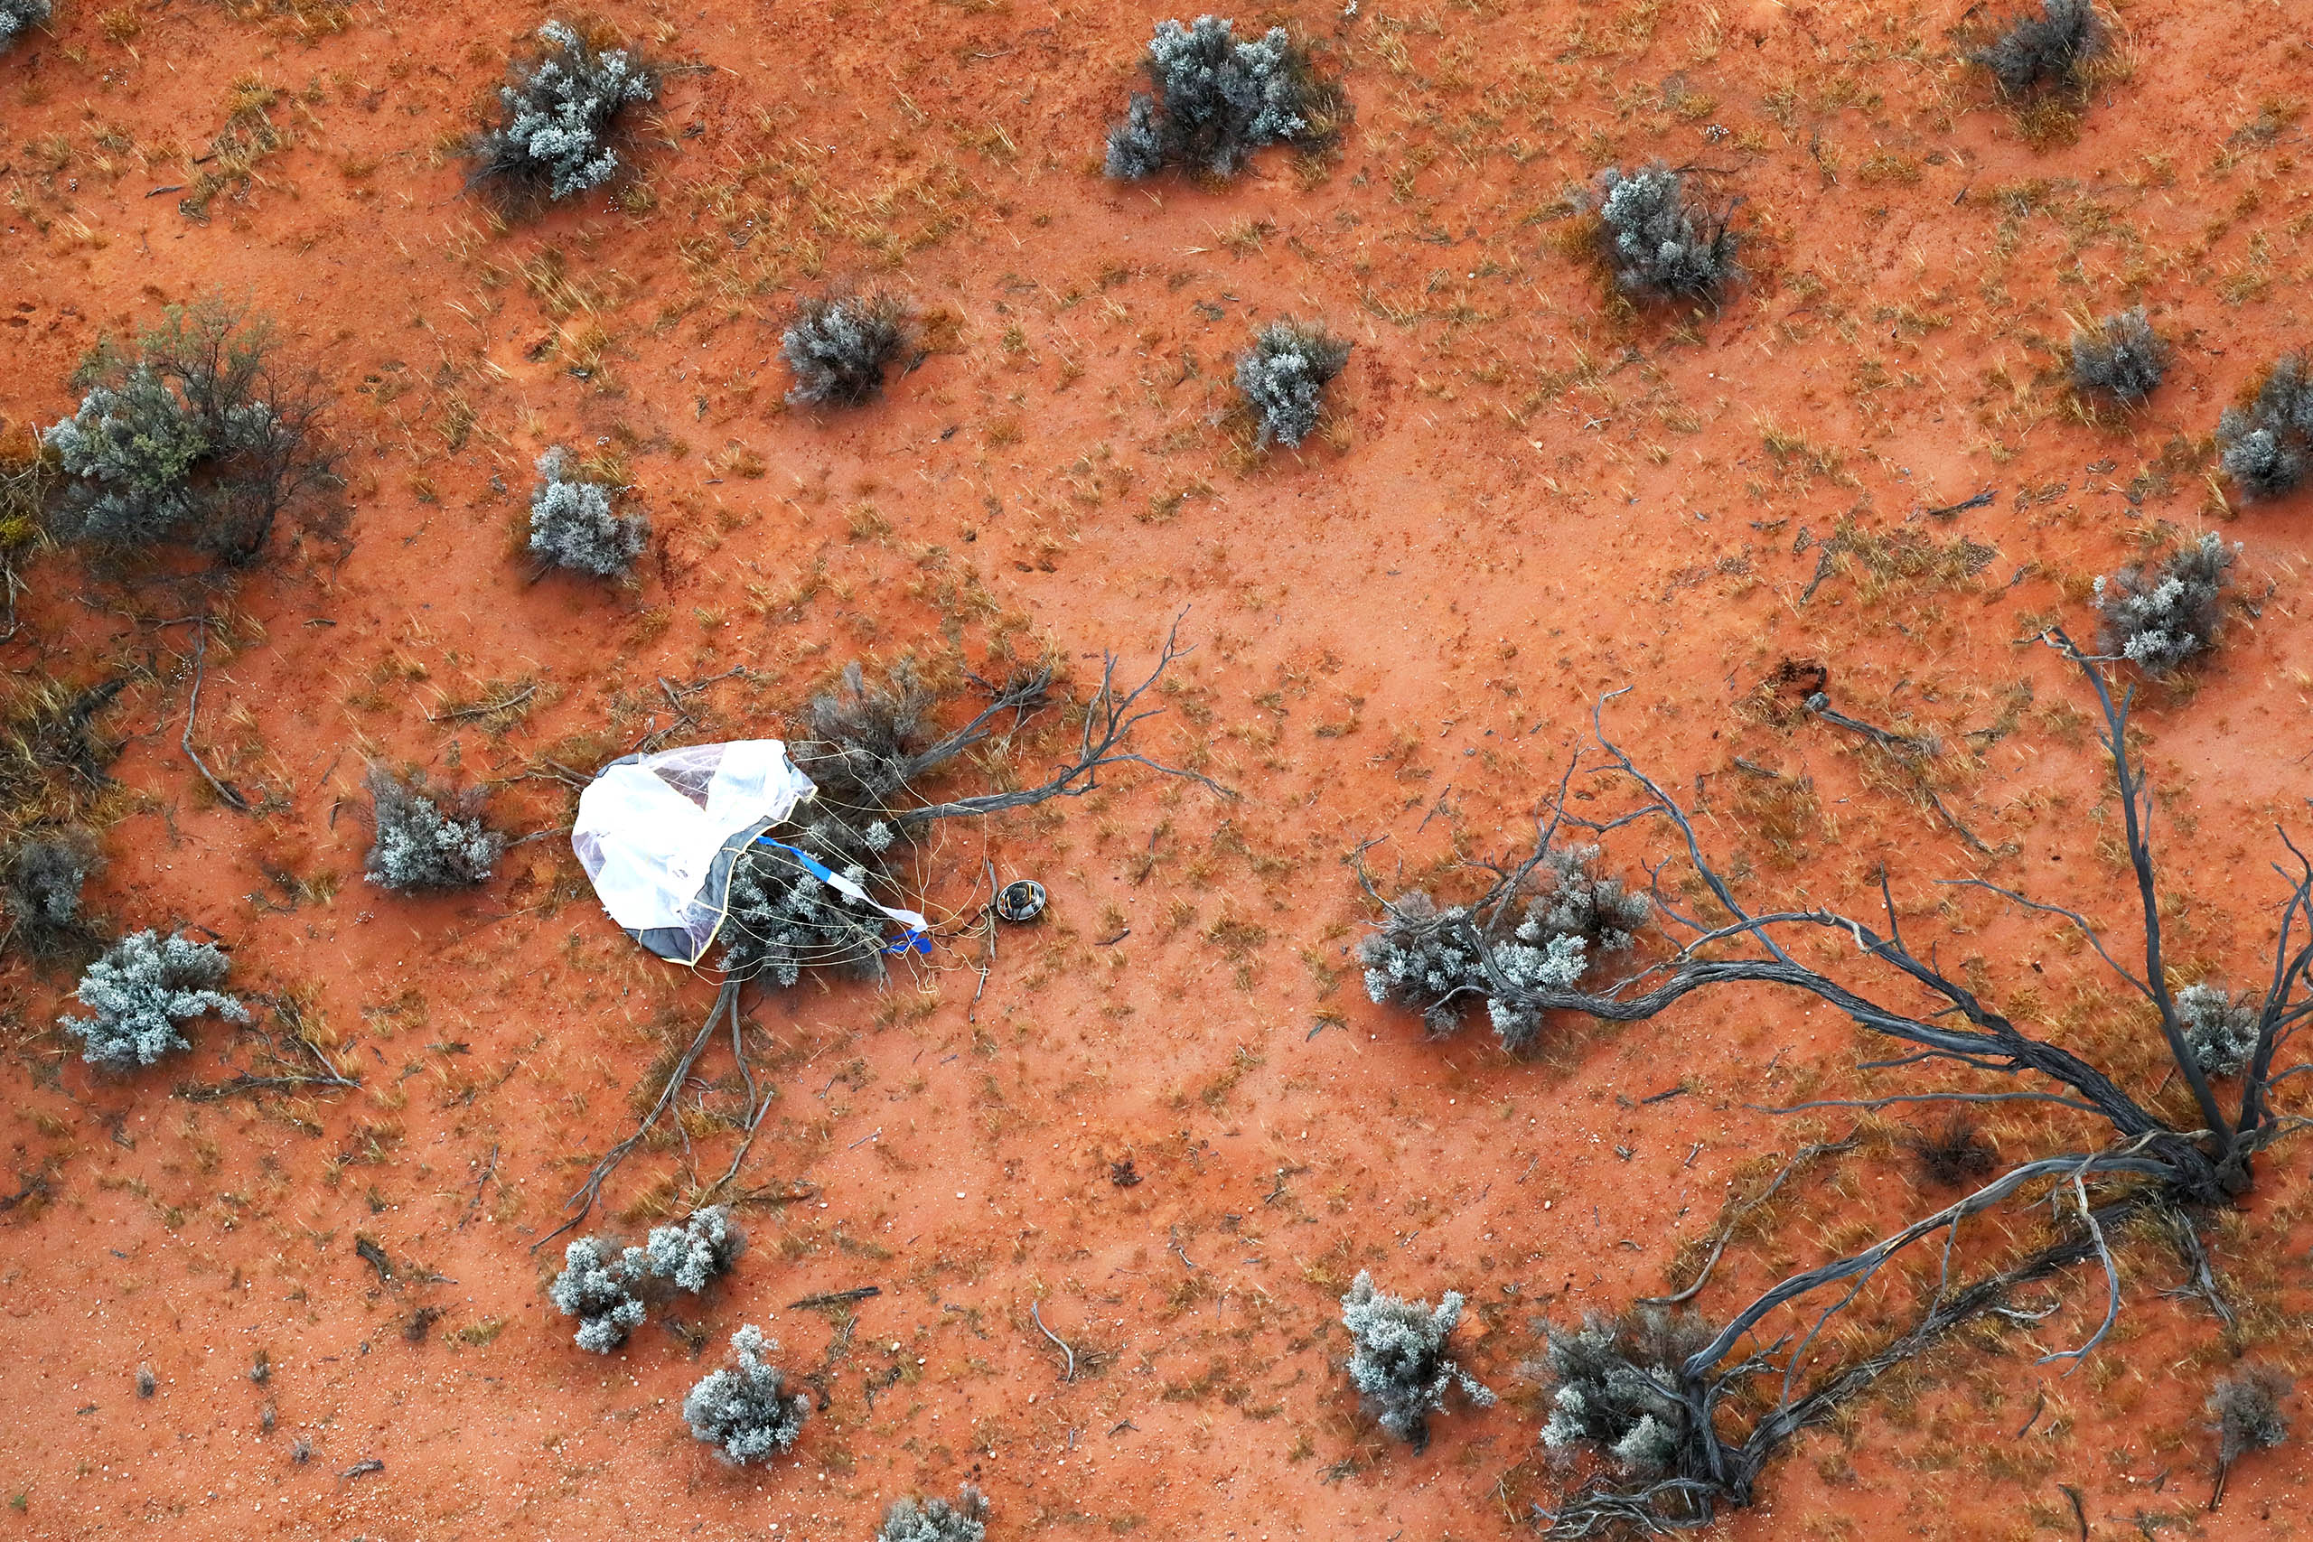

Slide 3
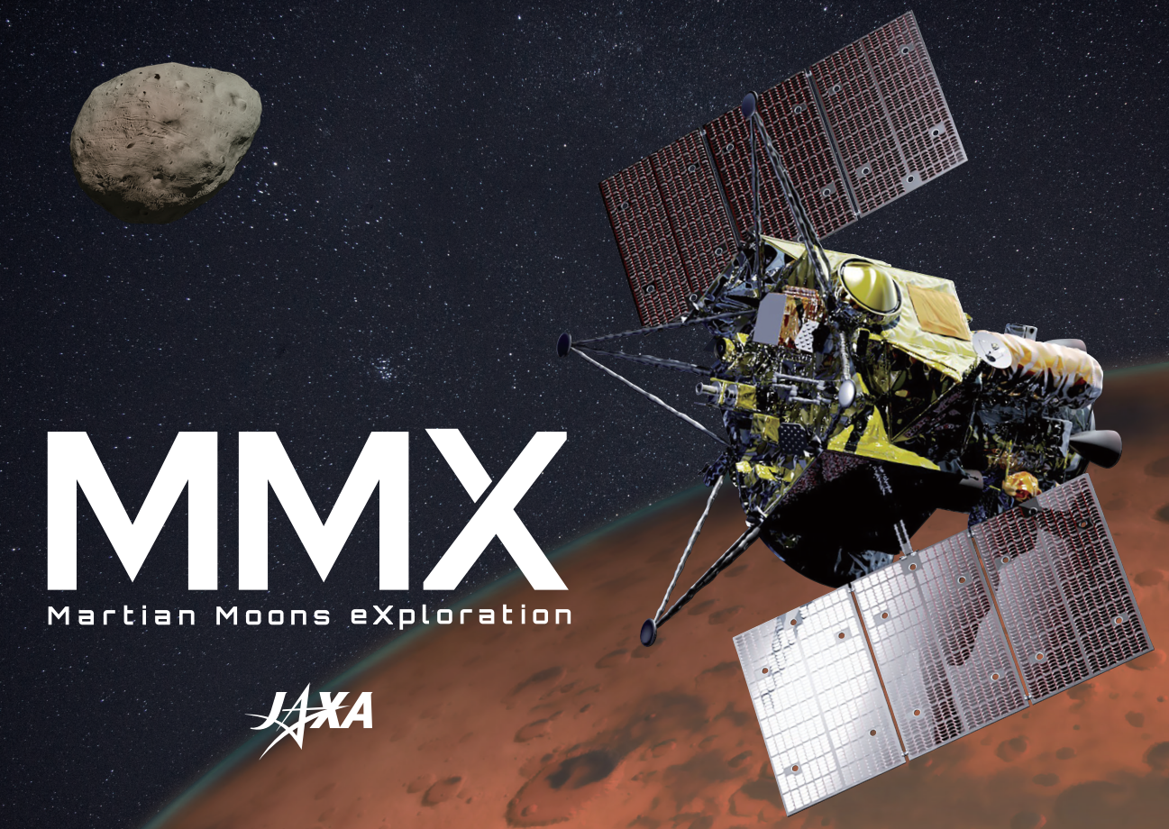

Slide 4
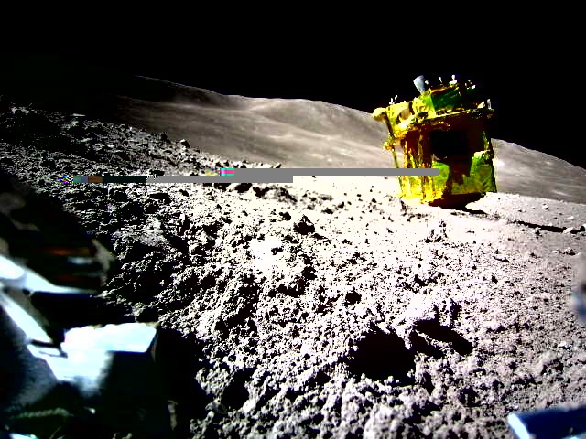
JAXA
Takara Tomy
SONY
Doshisha Univ

Slide 5
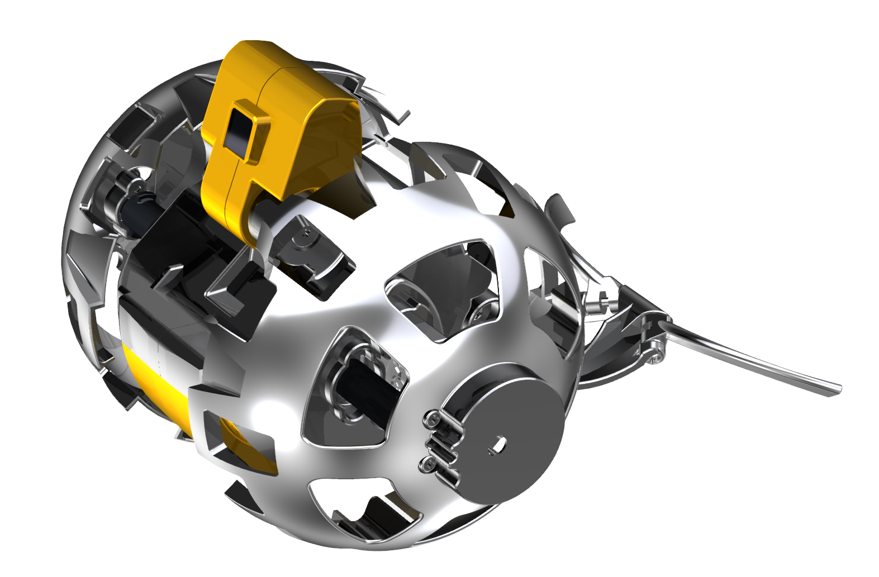
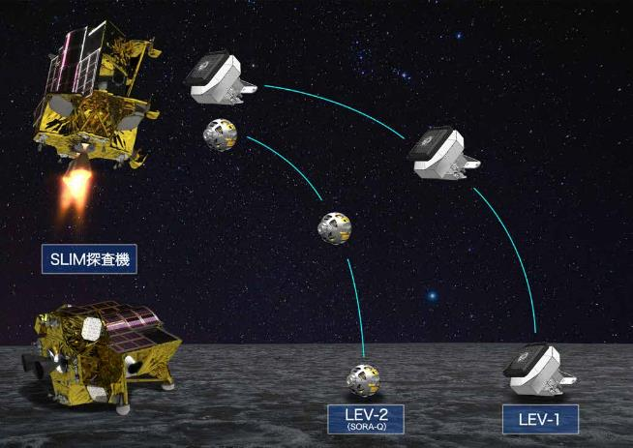
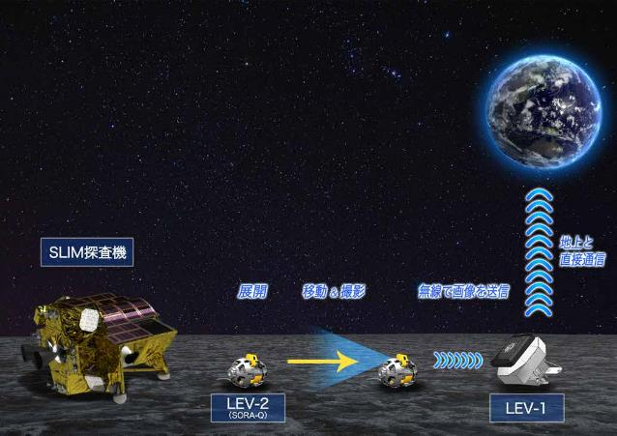
Who took the picture?
JAXA
Takara Tomy
SONY
Doshisha Univ

Slide 6
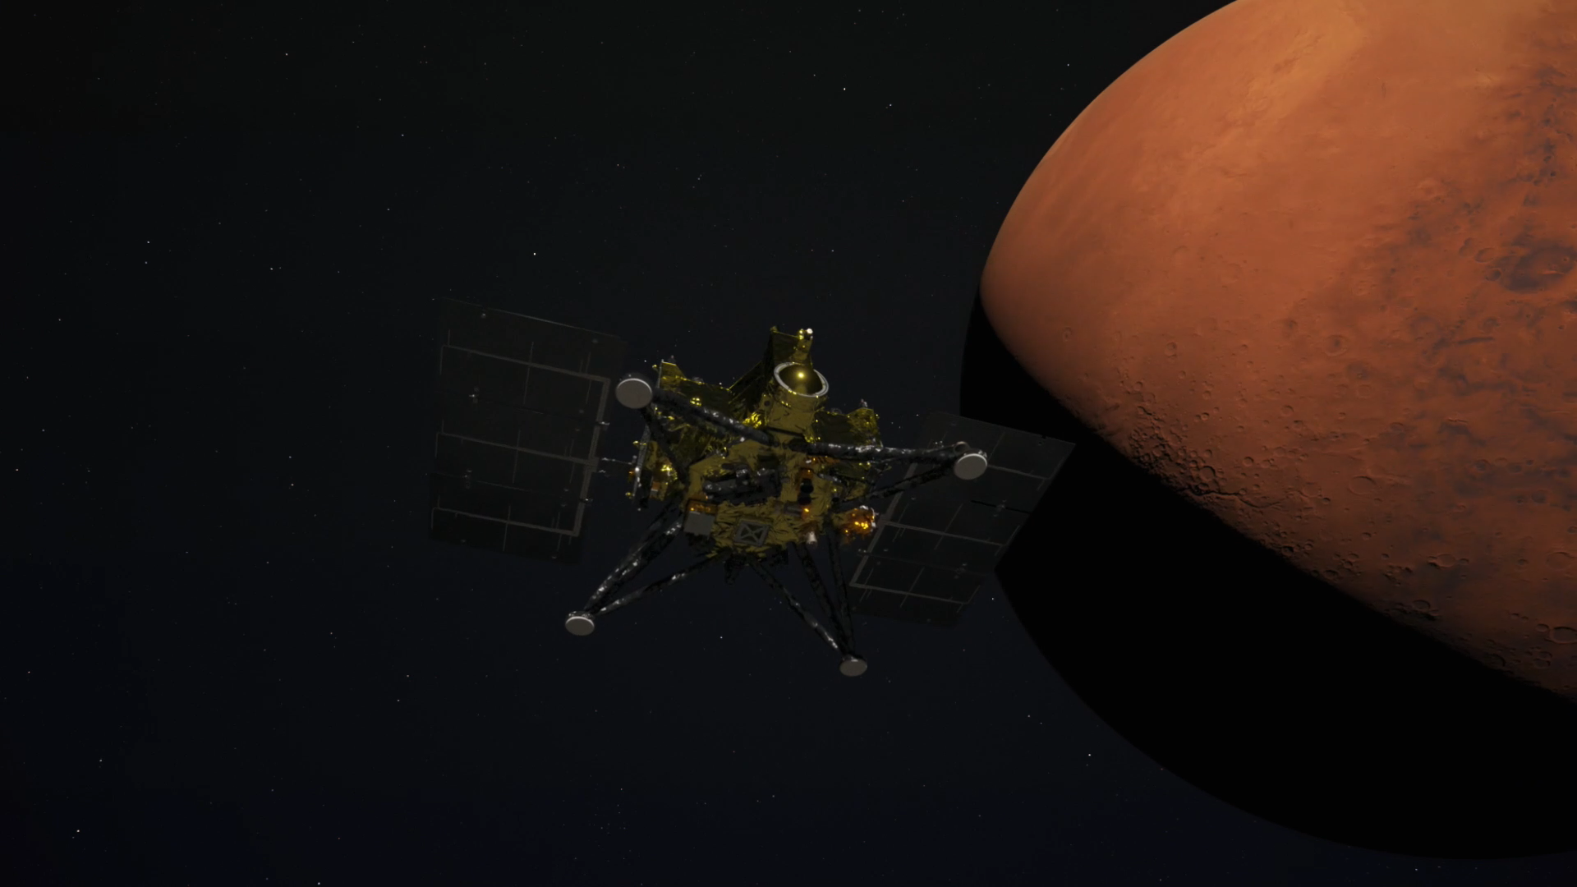

Slide 7
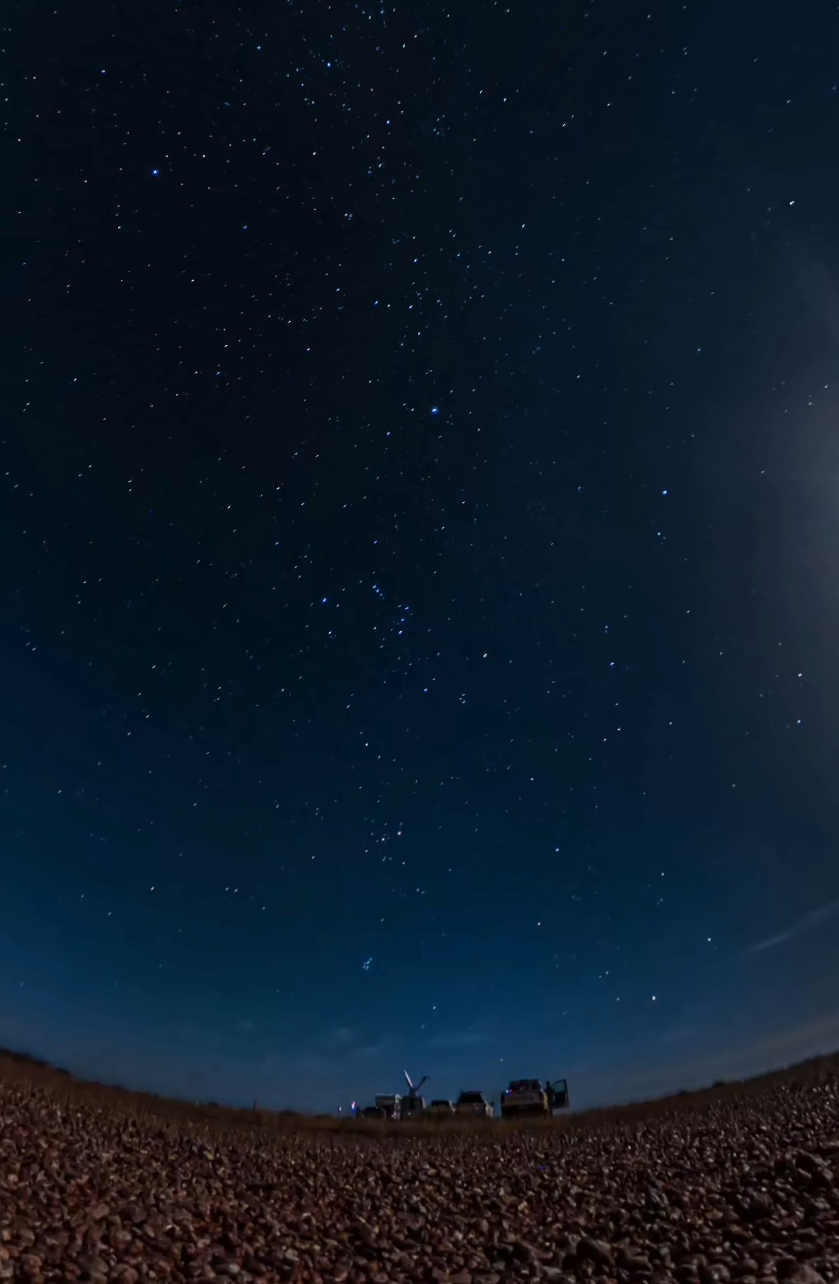

Slide 8
Yes, MMX is a nice business card for entering the Mars exploration club
Hayabusa2, SLIM, MMX, …
I have been thinking that one more key is needed to plan seriously about JAXA’s way of Mars landing exploration

Slide 9
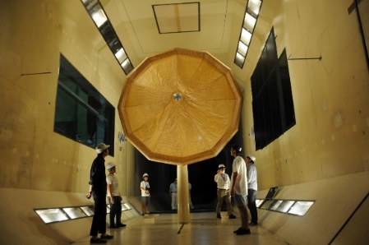
Inflatable soft aeroshell to democratize
Mars landing exploration

Slide 10
